Slide 1
2018-2019

Slide 2
Welcome!
Sign in
Find your child’s desk
Write and draw a picture for your child while you wait!

Slide 3
Agenda
About Me
Housekeeping
Homework
Volunteering
Communication
Curriculum
Questions?

Slide 4
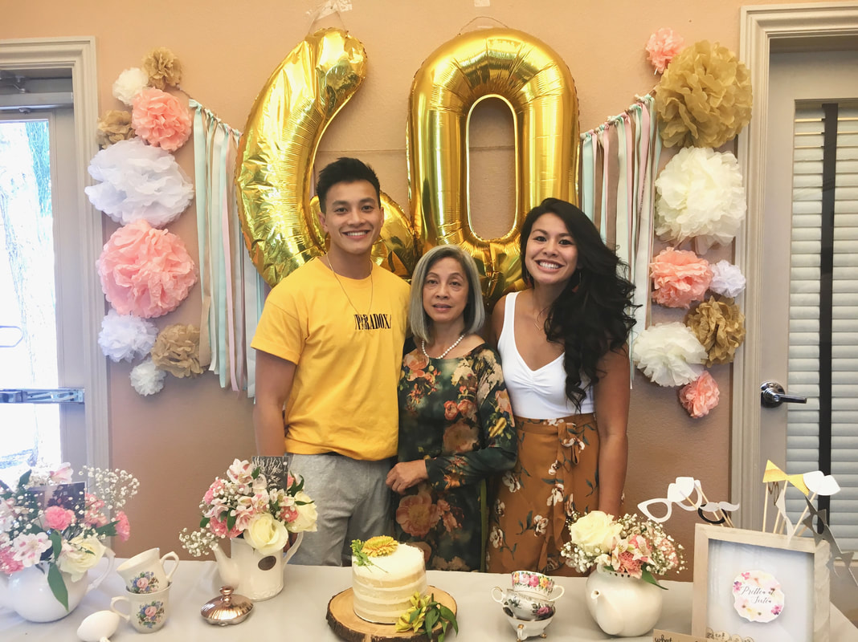
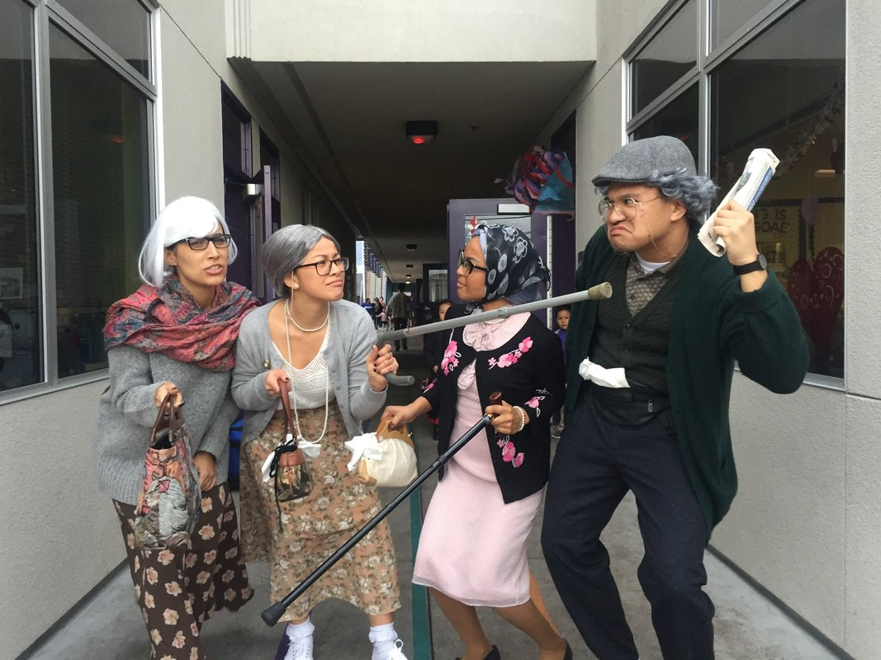
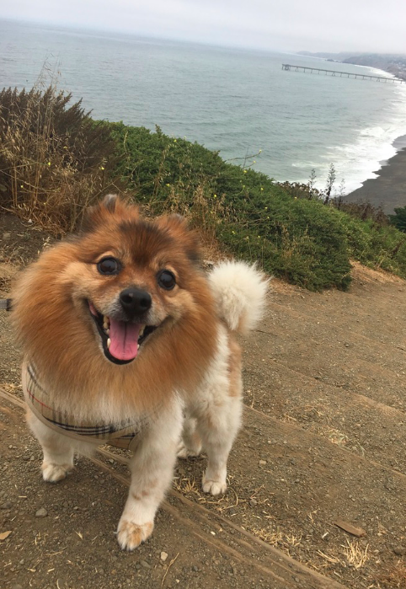
Meet your teacher!
Hanh-Nhi Pham
SJSU
San Jose
7th year in education
Vegan
https://phamlw.weebly.com
Notes:
Parent survey!

Slide 5
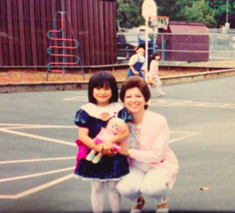
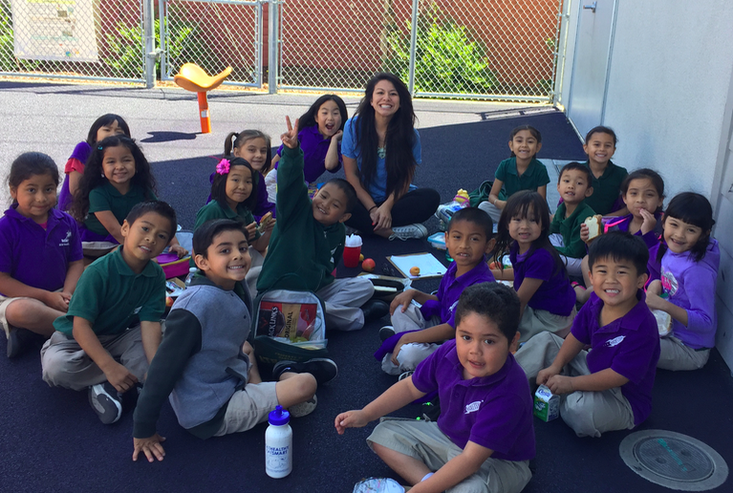
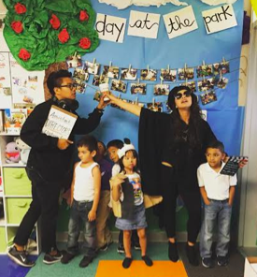
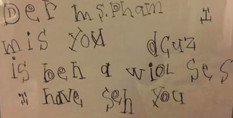
Why I’m here
“Remember one thing. That you should not leave the earth until you have made it a little more beautiful, a little lovelier, a little more loving."- Osho
“She just won’t stop talking but she’s trying!”
Be kind to all kinds
“I don’t know it, yet.”
Notes:
Teaching to the whole child and focusing on SEL
Acceptance of diversity and seeing our difference as beautiful and special
Growth mindset fostering independence and people who are curious about the world- life long learners!

Slide 6
Housekeeping
Schedule | Food
Full day starts Monday, October 2nd 8:00-2:10 Every Friday dismissal is at 12:30 Teacher learning days dismissal is at 12:30 Students will be in the office if you arrive 5 minutes or later for pick up | Lunch begins Monday, October 2nd Students can bring healthy cold lunches or buy hot lunches from school Hot lunches can be accessed at: www.EZSchoolPay.com Money can be turned in online or at the office

Slide 7
Upcoming Dates
9/13, 6-7pm Family reading night
9/24-9/28, Parent Conferences
9/27, 6-7 pm First PTA meeting

Slide 8
Conferences
September 24th - September 28th
Report Cards will not be given during conferences
Report Cards are given 3 times a year
** Please sign up for a conference slot today! **

Slide 9
Homework
Read every night with your child
*Books in car, siblings can read
*Read in any language
*Public library great place to get books
*Please let me know if you need books!
Book bags
Practice life skills (tying shoes, washing hands, opening bags, etc.)
**Practice work will be given to students on an as needed basis**

Slide 10
Volunteering
Ways you can get involved:
Prepare materials at home
Prepare materials in the classroom
Work with students in the classroom
Chaperone field trip(s)
What you need:
Volunteer form
TB test (valid for up to 4 years)

Slide 11
Lakewood Lions PTA
#lakewoodlionpta
Our Goals
1- Build school and family community
2- Support student learning
3- Fundraise to help supplement school resources, focusing on enrichment
4- Programs and resources for parents
STAY CONNECTED w/ Facebook
SAVE THE DATE
9/6 PTA Meeting @ 6:00pm in the Lakewood Staff Room
10/11 Lakewood’s Fun Run *Fundraising begins 10/1

Slide 12
Communication
ClassDojo
Thursday Folder
Room window
Behavior tracker
E-mail: hanh-nhi.pham@sesd.org
Website: http://phamlw.weebly.com

Slide 13
Clip Chart & behavior tracker/tabla de clip de comportamiento
Behavior tracker will be colored in daily
* Please reach out to teacher with any questions or concerns
Colors
Rainbow- You are a leader and are ready to make positive impact in the world!
Green- Trekking p the peak, you are making great choices!
Blue- Explorer, you’re ready to learn
Yellow- Slow path, slow it down think about what you can do better
White- Reflection, take some time at the calming corner to think about what you can do better.

Slide 14
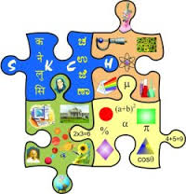
Curriculum
English Language Arts
Math
Science
Social Studies
SEL

Slide 15
Language Arts Curriculum
Writing first and last name
Concepts of print
Letter names and sounds
CVC blending
Sight words

Slide 16
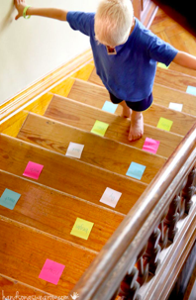
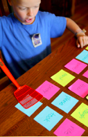
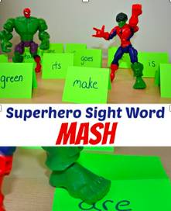
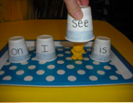
Sight Words
Sight words are words that we memorize so that we can read quickly and better understand the stories that we are reading

Slide 17
Math Curriculum
Numbers 0-20
1:1 Correspondence
Add and subtract between 0 - 10
Identify and describe the attributes of 2D and 3D shapes
Reasoning and problem solving

Slide 18
Questions?
Thank you for coming!

Slide 19
EXTRA SLIDES about Curriculum

Slide 20
Science Curriculum
Scientific Process
5-Senses
Land forms, water, air
Life cycles of plants & animals
Structure and physiology in plants and animals
Weather

Slide 21
Social Studies Curriculum
Citizenship
Community helpers
National celebrations
Famous Americans
U.S. symbols

Slide 22
Additional Curriculum
Starting Arts
*Dance
*Theater
*Music
Project Cornerstone
P.E.
PlayWorks
Field trips

