Slide 1
August 15, 2018

Slide 2
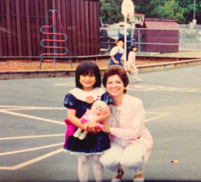
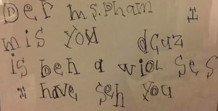
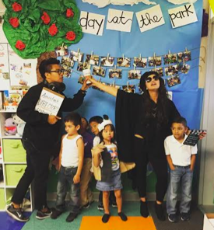
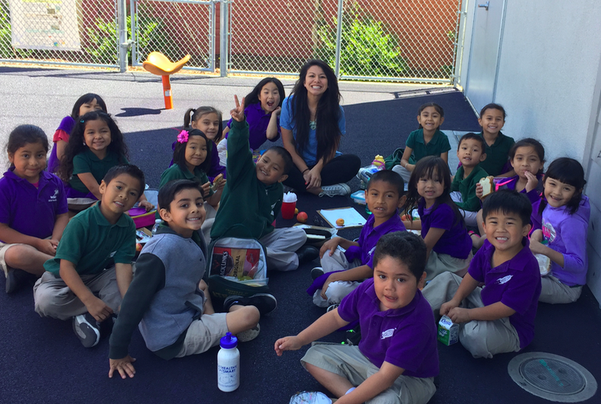
Meet your teacher!
Ms. Hanh-Nhi Pham
SJSU
7th year in education
Rocketship, VNEP
“She just won’t stop talking”, rapping, and scene!
Notes:
Parent survey!

Slide 3
Getting to school /llegar a la escuela
Half days
7:55-11:20am
*August 15th- September 28th
Full days
M-TH- 7:55- 2:10 pm
Friday- 7:55-12:30 pm
*Begins Monday, October 1st
Morning Drop off
Students are to be outside of the classroom by 7:55
Handshakes and smiles!
Afternoon Pick up:
Students are to be picked up from class door by a designated person

Slide 4
Bus logistics/ logística del autobús
Bus Tags
Students MUST wear their tags to school
Tags include student name and their stop
Please make sure return tags everyday to ensure your child gets onto the correct bus

Slide 5
After school care/cuidado después de la escuela
If you are interested in after school care please contact:
Desiree Briones
desiree.briones@ymcasv.org

Slide 6
Kindergarten Assessments/evaluación de kínder
What
Assessment around letter recognition, phonics, math, and language
Why: Identifying strengths and growth areas to guide lessons and differentiation
When
August 20th- September 21st
1 hour testing block
How: Please sign up asap!
Notes:
**If you indicated on your registration forms that you speak a language other than English in your home, we have an additional assessment that is time sensitive. Please secure an assessment time, ideally within the first week.

Slide 7
Food/ comida
Breakfast
Please make sure your child has a healthy breakfast daily so their brains and hearts are ready to learn!
Snacks
Snacks are not provided by the cafeteria during recess
Please pack a healthy snack daily
Lunch
*Students start lunch Monday, October 1st
Healthy lunch from home OR purchased hot lunch from school
Hot lunches can be paid for at the office or online: www.EZSchoolPay.com
Allergies
*Nut free school
Please inform your teacher and office of any allergies asap
Notes:
**Hot lunch forms are on the back table - please get these into the office as soon as possible.

Slide 8
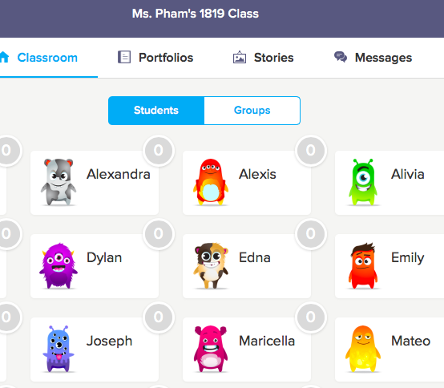
Class dojo/clase dojo
Sharing videos and pictures
A way to message and text teacher and parents
Connection between home and school
A flyer will be sent home with directions on how to download and access the app!

Slide 9
Clip Chart & behavior tracker/tabla de clip de comportamiento
Behavior tracker will be colored in daily
* Please reach out to teacher with any questions or concerns
Colors
Rainbow- You are a leader and are ready to make positive impact in the world!
Green- Trekking p the peak, you are making great choices!
Blue- Explorer, you’re ready to learn
Yellow- Slow path, slow it down think about what you can do better
White- Reflection, take some time at the calming corner to think about what you can do better.

Slide 10
Student number/rastreador de comportamiento y número de estudiante
Practice, Practice, Practice!
Writing, identifying, saying
Numbers are used for:
Lining up
Clip chart
Seating
Participation

Slide 11
Materials/ materiales
Donations
Thank you in advance for all your generous donations!
Wishlists on parent highlight window
Blue Lakewood Folders
Important information will be sent home in this every Thursday
Please read and return folder by Friday
Check folder daily for behavior chart
Notes:
**Hot lunch forms are on the back table - please get these into the office as soon as possible.

Slide 12
What to wear/ qué ponerse
Shoes
Velcro or slip-ons
* If your child is still learning to tie their shoes
Labels
First name and first letter of last name
Sweaters, lunch boxes, backpacks, etc.
Buttons, Zippers, Fasteners
Please practice this at home with your child
Notes:
**Hot lunch forms are on the back table - please get these into the office as soon as possible.

Slide 13
volunteer/ voluntario
Why
Interest & support in your chid’s learning
Building community and relationships
Teachers have more opportunities for focused, meaningful instruction
How
Prep materials at home
Help in the classroom
Chaperone Field trips
Parent led workshops
Notes:
**If you are interested in volunteering, please fill out a volunteer packet in your child’s classroom.

Slide 14
Upcoming events/ próximos eventos
Back to School BBQ
August 19th @ 1:00 pm
PTA’s first event of the year
Come meet teachers and other families!
Back to School Night
August 30th 6:00-7:30 pm
Learn more about Kinder curriculum
See what your child has been learning!
Family Conferences
September 24th- 28th
Mandatory opportunity to meet with teacher to discuss student progress, strengths, and opportunity for growth!

Slide 15
Don’t forget.../ no lo olvides
Sign up for an assessment time
Grab parent volunteer packet
Fill out bus form
Pick up lunch form (turn into office)
Drop off any generous materials donations
Pick up your cutie at 11:20 :)

