Slide 1
Welcome to Sight Word Night

Slide 2
Agenda
What are “Sight Words” and the importance of them
How to practice at home
Questions/Closing

Slide 3
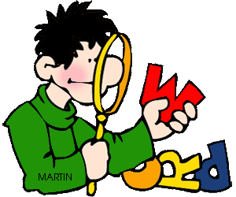
What Are “Sight Words”
Sight words are words that we memorize so that we can read quickly and better understand the stories that we are reading
Sight words are also commonly known as “High Frequency Words” because they appear quite frequently in the books and words that we are reading
Examples: a, the, I, she, he, in, that, what, on etc.

Slide 4
What Are “Sight Words” cont…
In kindergarten, every child must leave knowing 100 sight words
These are grouped by lists of ten, so every child will master List 1 – List 10
This list can be found in your child’s literacy packet
If your child does not master these sight words by the end of kindergarten, they will fall behind in their reading and comprehension in the coming years

Slide 5
How to Practice at Home
Know what list your child is on
Once you know what list your child is on, then you can introduce 1 new word at a time. Do not move on to new words, until your child has mastered that word.
Your child will show that he/she has mastered it only if they can say the word quickly, within 5 seconds. If they say it after that, they do not have it memorized.
Your child does not need to know how to spell it or write, only to identify it by sight.

Slide 6
How to Practice at Home cont…
Example Schedule of teaching new word…
Monday: teach “a”
Tuesday: review “a” and if mastered teach “she”
Wednesday: review “a”, “she”
Thursday: review “a”, “she”, and teach “he”
Etc…

Slide 7
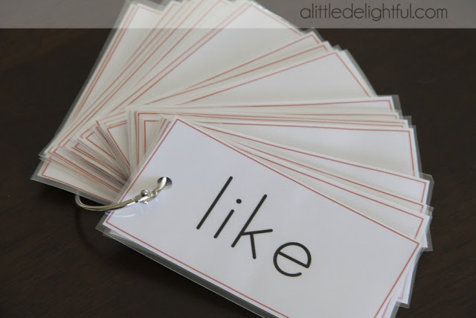
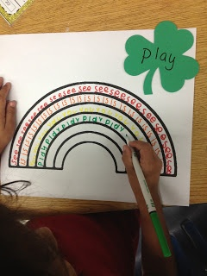
How to Practice at Home cont…
You can practice “Sight Words” by…
Flash cards
Finding them in books together
Find them and circling them newspapers, cereal boxes, magazines, etc.
Writing them over and over (while saying them) in different colors
Etc. (Any way that will help your child learn them!)

Slide 8
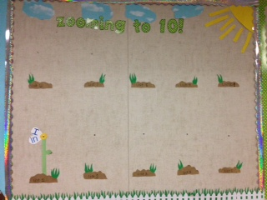
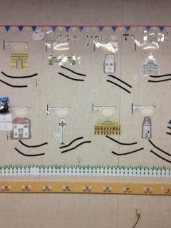
We Will Meet Our Goal!!!
Remember our Big Goal for Kindergarten is List 10! We can do this TOGETHER!
If you have any questions please let us know and if you have any great tips that you can share to help other parents let us know as well so we can spread the word!
We will be checking our students growth every 2 weeks, to make sure that they are on track. We are looking for parent volunteers to help us test them those Friday mornings. If you are interested, please sign up on our list before you leave tonight!

Slide 9
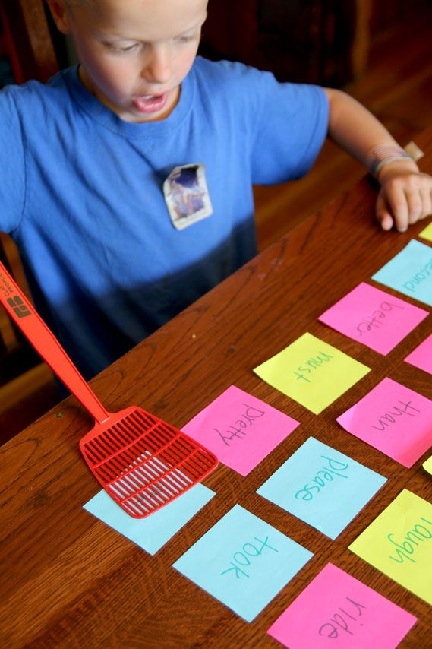
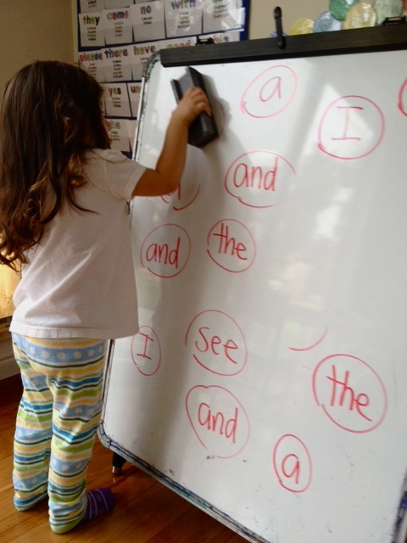
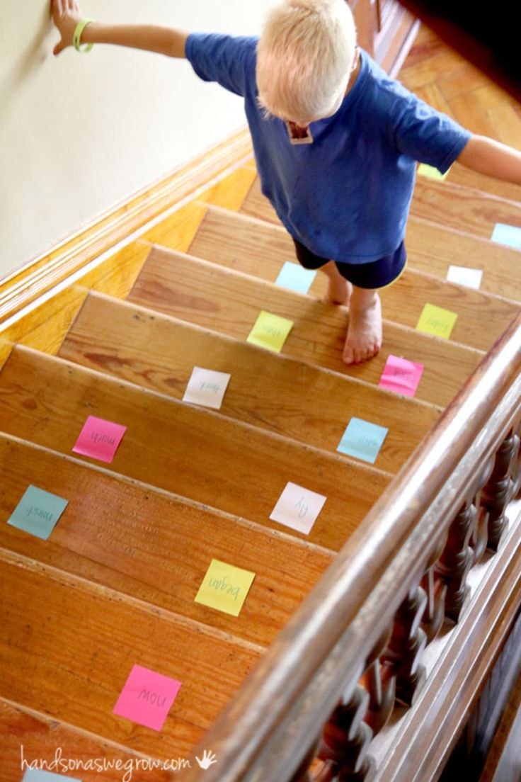
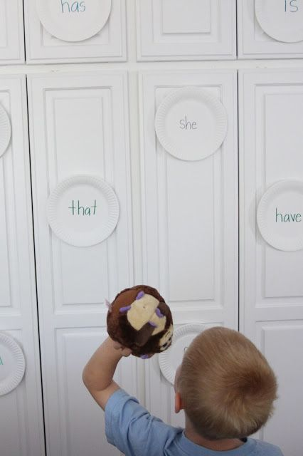
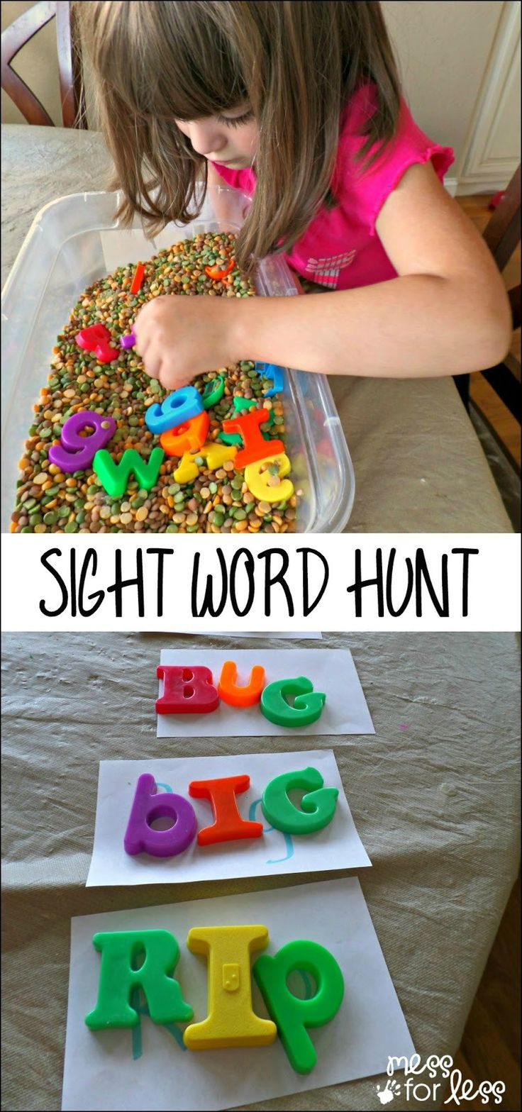
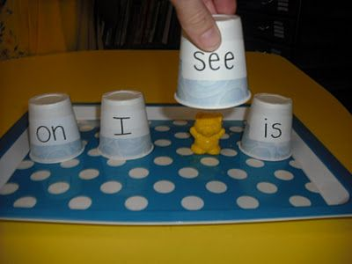
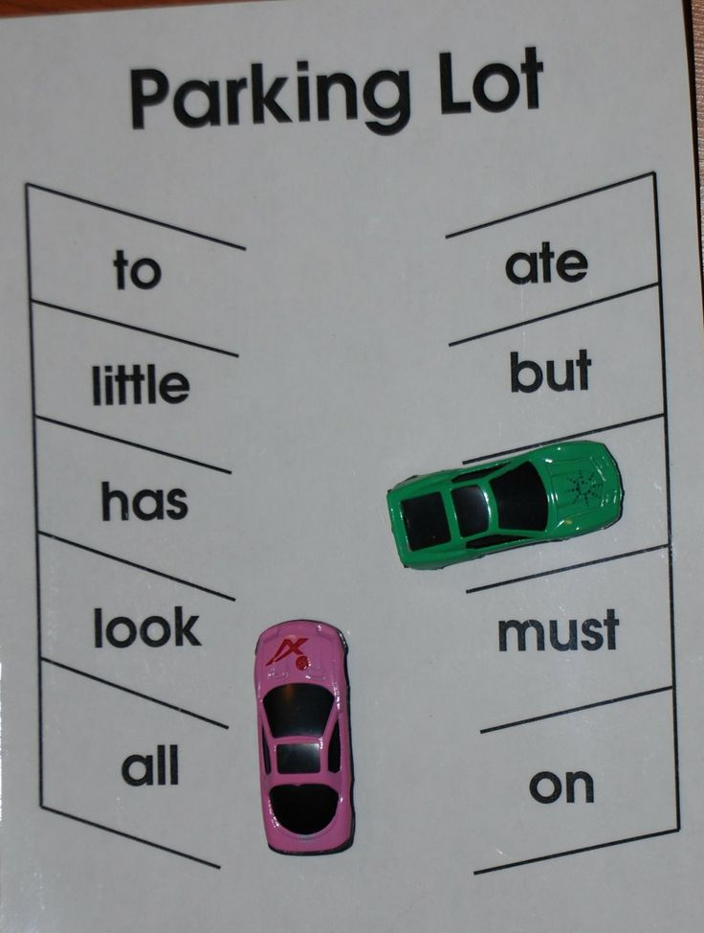
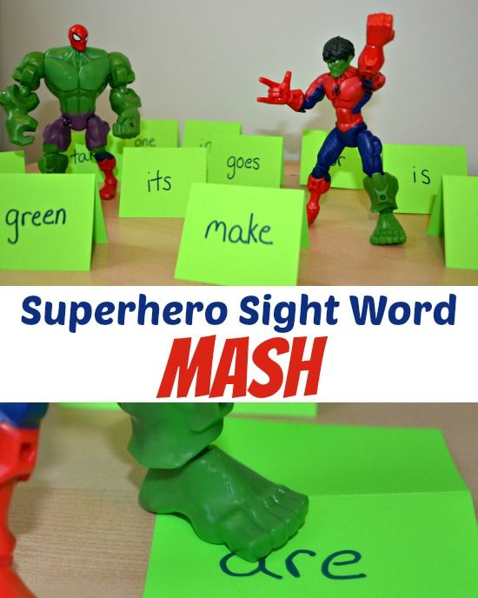
Fun ways to practice

